Slide 1
4th Year IoT Project Aquarium Monitoring System: HCFF
Mettre futur logo
Julien Rose, Achille Bayart, Nicolas Rigaudy

Slide 2
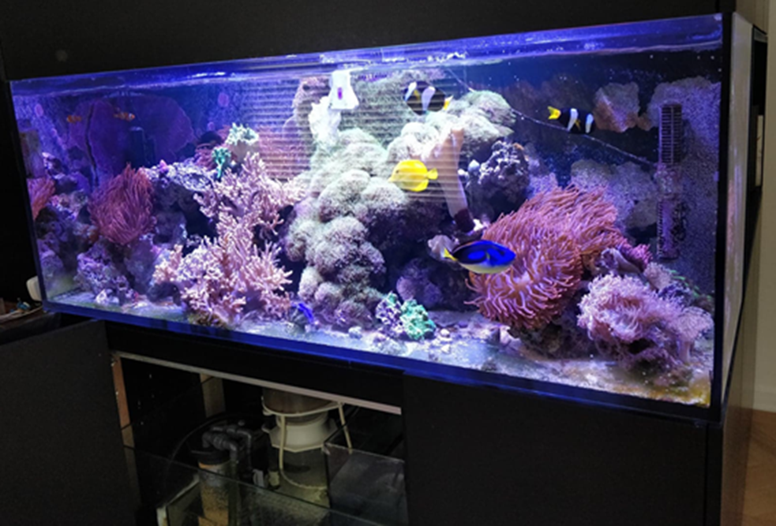
Introduction and context
Aim of the project ?
Working on a seawater aquarium which is composed of many fishes species

Slide 3
Completed work - Hardware
Raspberry Pi
Mettre photos du set up de la raspberry avec la caméra également etc

Slide 4
Completed work - Hardware
Temperature
Mettre photos du montage avec le double capteurs (tests dans l’aquarium) + explication du code python qui sauvegarde la moyenne dans un fichier texte.

Slide 5
Completed work - Hardware
Brightness
Photos du montage avec le capteur de luminosité + code

Slide 6
Completed work - Image Recognition
Initial Idea

Slide 7
Completed work - Image Recognition
OpenCv

Slide 8
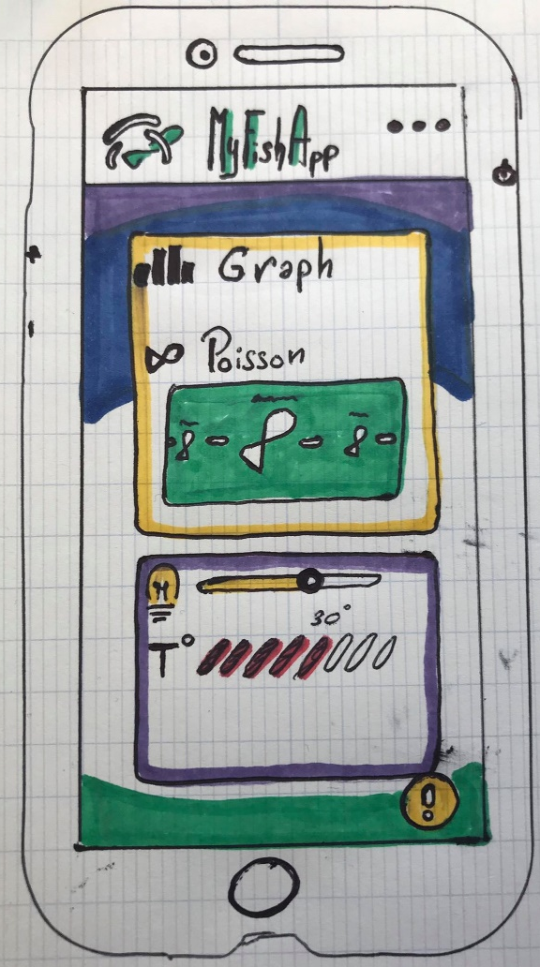
Completed work - Android App
Schématisation :
Meets the Needs:
FP1 : Check the visual information of health of the fish.
FP2 : Show the information of the aquarium for the viewer.
FC1: Monitor the level of water
That Should be:
Entertaining
Intuitive
Smart interface

Slide 9
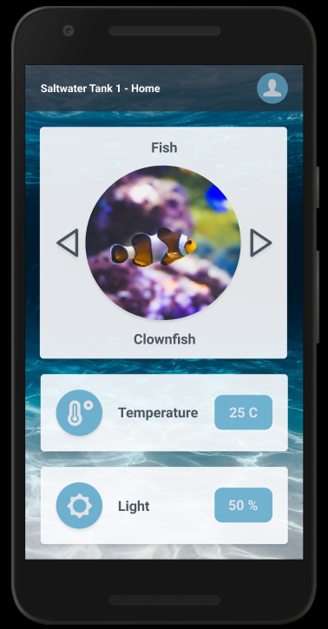
Completed work - Android App
Figma :
Prototype our ideas.
Simplify the way between drawing
and code.
Add code to see how to create
interface.
Entertainment part
Main information of the Aquarium

Slide 10
Completed work - Android App
Android Studio

Slide 11
Completed work - Data collection and linking
Rest Client

Slide 12
Project perspective
Planned additions
Challenges

Slide 13
Conclusion

Slide 14
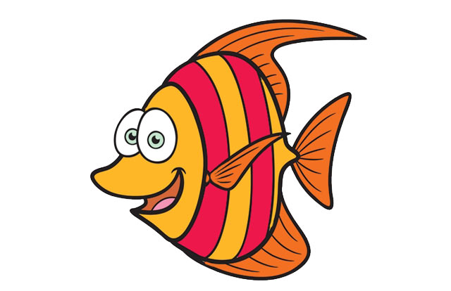
Thanks for listening
And see you in september!

